Slide 1

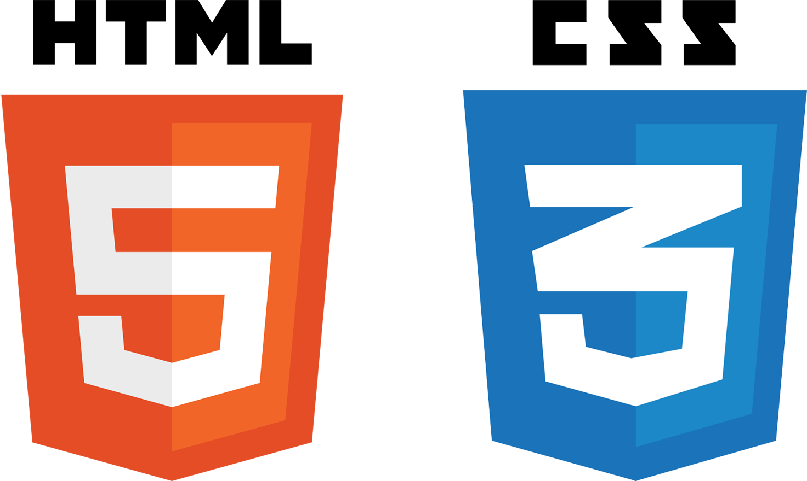



Coding - Roadmap
Vanilla JS
JS Library
1) To-do list
Chose
React or jQuery
React or jQuery
2) Interaction
Feedback
or
Something new
Ubermensch_0608

